Slide 1

Creating an Agent-less Host Intrusion Detection System using PowerShell and WMI
Jared Atkinson & Matt Graeber

Slide 2
Introduction
Matt Graeber - @mattifestation
R&D Capability Lead – Veris Group – Adaptive Threat Division
Former:
Malware Reverse Engineer at FireEye (FLARE Team)
Read Team Operator at government red team
U.S. Navy Linguist
Cloud and Datacenter Management MVP – PowerShell
Neither a cloud nor a datacenter expert, FYI.
Creator of PowerSploit, PowerShellArsenal, etc.

Slide 3
Introduction
Jared Atkinson - @jaredcatkinson
Hunt Technical Lead – Veris Group – Adaptive Threat Division
Former
U.S. Air Force Hunt (2011 – 2015)
2015 Black Hat Minesweeper Champion
Moderator of the PowerShell.com “Security Forum”
Developer of
PowerForensics
WMIEvent
Uproot IDS

Slide 4
What is Uproot?
Uproot
Host based Intrusion Detection System built on permanent WMI event subscriptions
Leverages WmiEvent module to easily manage subscriptions
WmiEvent
PowerShell module that abstracts the complexities of permanent WMI event subscriptions

Slide 5
Why are we here?
Matt – Some colleagues were investigating a breach involving WMI persistence and I was asked how one would effectively detect the creation of permanent WMI event subscriptions.
Jared – As a consultant, we are often not allowed to dictate configuration changes or software additions, but are responsible for near real-time monitoring. Permanent WMI event subscriptions offer support across all versions of Windows (past and present) for monitoring system changes as they happen.

Slide 6
WMI Eventing Refresher – Event Classes
Two types of event classes:
Extrinsic:
“not linked to changes in the WMI data model”¹ – i.e. provider specific
Does not require a polling interval – i.e. no missed firings
Limited set
E.g. RegistryKeyChangeEvent
Intrinsic:
“occurs in response to a change in the standard WMI data model”¹
Requires polling interval – i.e. can miss firings
Limited only by the classes present in the WMI repository
E.g. __InstanceCreationEvent
¹ – “Determining the Type of Event to Receive” https://msdn.microsoft.com/en-us/library/windows/desktop/aa390355(v=vs.85).aspx

Slide 7
WMI Eventing Refresher – Events
Local WMI events
Register-WmiEvent, Register-CimIndicationEvent
Permanent WMI events
Set-WmiInstance, New-CimInstance
Requires the following instances:
__EventConsumerClass – e.g. CommandLineEventConsumer
__EventFilter – WMI event query
__FilterToConsumerBinding
Notes:
I’ll show some sample __EventFilters on the next slide

Slide 8
WMI Eventing Refresher – __EventFilter
Intrinsic event filter example:
SELECT * FROM __InstanceModificationEvent WITHIN 5 WHERE TargetInstance ISA 'Win32_Service' and TargetInstance.State = 'Running‘
SELECT * FROM __InstanceCreationEvent WITHIN 10 WHERE TargetInstance ISA 'Win32_StartupCommand'
Extrinsic event filter example:
SELECT * FROM Win32_VolumeChangeEvent WHERE EventType = 2
SELECT * FROM Win32_ProcessStartTrace WHERE ProcessName LIKE '%chrome%'

Slide 9
WMI Eventing Refresher – __EventConsumer
Standard event consumers
LogFileEventConsumer
ActiveScriptEventConsumer
NTEventLogEventConsumer
SMTPEventConsumer
CommandLineEventConsumer
Notes:
Speak to the ones beneficial to defenders and attackers

Slide 10
“Signature” Development – Methodology (1/3)
Identify what you’d like to detect.
i.e. Identify common attacker actions
Service creation
Registry persistence – think Autoruns
Lateral movement
WMI persistence
Etc.
Consider if there is already current detection
Event log entries
Command-line auditing
Applocker
Notes:
Assuming there is no current, straightforward means of detection, let’s go down the path of using WMI for detection.

Slide 11
“Signature” Development – Methodology (2/3)
Prioritize utilization of extrinsic event classes
No chance of missing events – no polling interval required
Fall back to intrinsic events if necessary
But how do I know what events are available???
PowerShell, of course!
Demo time

Slide 12
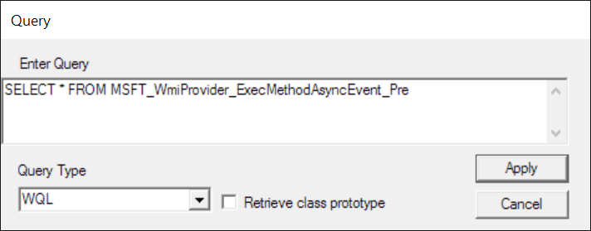
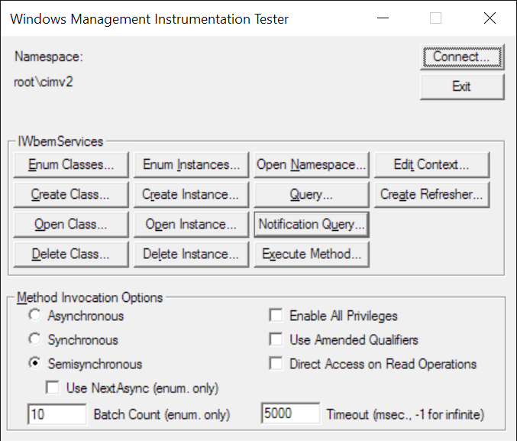
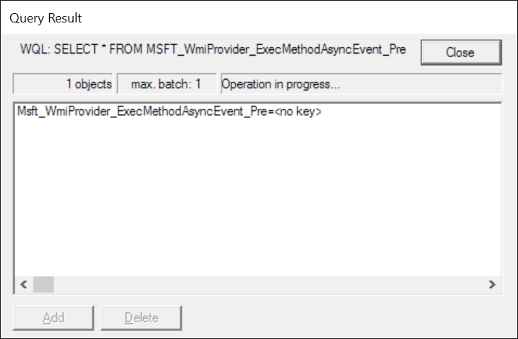
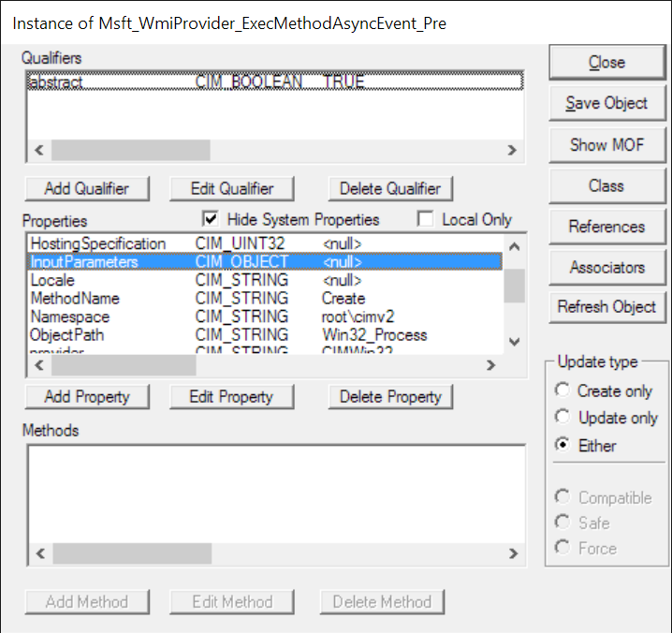
“Signature” Development – Methodology (3/3)
wbemtest.exe
Notes:
i.e. the quick and dirty testing methodology. This is only for illustration purposes. Jump into a demo here

Slide 13
“Signature” Development - Scenario
You have a good idea of attacker actions but you don’t have a specific WMI class for detection in mind.
E.g. lateral movement
Is there a Win32_LateralMovement class??? No. ☹
Let’s explore a bit and see if there are any events that stand out.
Some creativity required…
Demo time

Slide 14
“Signature” Development - Results
As a result of exploring extrinsic events, we came up with some of the following signatures:
SELECT * FROM MSFT_WmiProvider_ExecMethodAsyncEvent_Pre WHERE ObjectPath="Win32_Process" AND MethodName="Create"
SELECT * FROM MSFT_WmiProvider_ExecMethodAsyncEvent_Pre WHERE ObjectPath="StdRegProv"
SELECT * FROM Win32_ModuleLoadTrace WHERE FileName LIKE "%System.Management.Automation%.dll%"
SELECT * FROM __ClassCreationEvent
SELECT * FROM MSFT_WmiProvider_CreateInstanceEnumAsyncEvent_Pre WHERE ClassName="Win32_Process"

